Slide 1
Password Auditing Lab
Wednesday Afternoon

Slide 2
Authentication and Authorization
Authenticate – verify ID (you are who you say you are)
Something you know (password)*
Something you have (SMS phone, RSA key)
Something you are (biometrics like fingerprint)
Authorize – grant access to resources based on authentication
R-BAC – based on your role

Slide 3
Password Auditing Lab Objectives
Understand what makes weak and strong passwords
Demonstrate creating hashes from plain text passwords
Demonstrate how to use password cracking tools
Understand the difference between dictionary and brute force password cracking

Slide 4
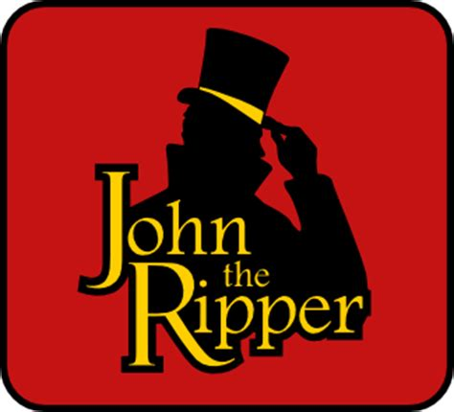
Password Auditing*
Review and learn about password files in Linux
Using the John the Ripper
Free password auditing (cracking) tool
Find trivial passwords in a short amount of time
Accessible on multiple platforms
Can be run from within Metasploit or on its own
Takes the entry from salted password hash from /etc/shadow:
jsmith:$6$JRF8OgFTYSP1zDeO$2PuYhV7jFxrdY8x.4P73BspAXQZiv2S8Dr.hrFIGNXTWrIt6gdTiwnTr9cTgFurP4NPWT8isXwizoGRqt/iJ./:18659:0:99999:7:::
Reduces it to the password: 12345
*Hint: be careful where you use the word “hack”

Slide 5
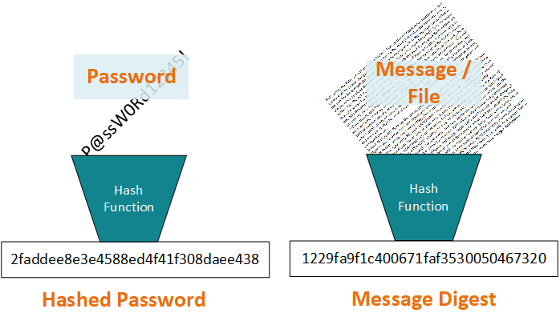
Background: What is a Hash?
A hash function maps digital data of arbitrary size to digital data of fixed size. The hash is sometimes called a message digest.
A cryptographic hash function is a hash function that is considered practically impossible to reverse (one-way-ness) or find collisions (i.e. two messages with the same hash value)
Same cryptographic hash function can be used.

Slide 6

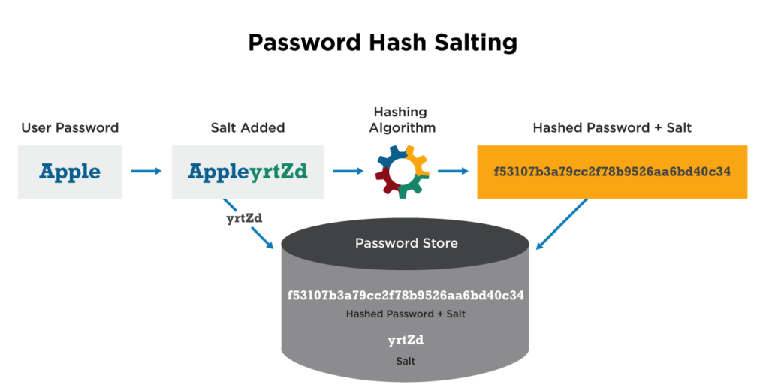
Password Hashing with Salt
Passwords aren’t stored in plaintext or plain hash, they are salted
Prevents Rainbow Table Attacks
🌈 Attack a hashed password in reverse with a table of pre-computed hashes with corresponding passwords 🌈
Adds a layer of security (Defense in Depth)
Image from https://cyberhoot.com/cybrary/password-salting/

Slide 7
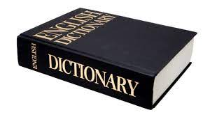
Dictionaries in John
Not like the dictionary you think of
A list of words to try against the password hashes
Image source: https://images2.minutemediacdn.com/image/upload/c_fill,g_auto,h_1248,w_2220/f_auto,q_auto,w_1100/v1555926333/shape/mentalfloss/166091799.jpg

Slide 8
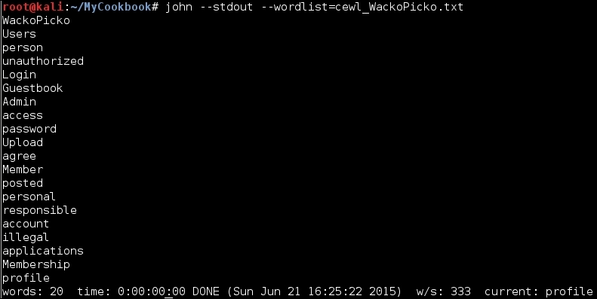
Custom Dictionaries in John
List 1:
cat
dog
panda
racoon
deer
List 2:
cat
dog
panda
racoon
deer
panther
puma
bear
chicken
corgy
welshcorgy
bordercollie
jump
run
audit
goat
horse
palamino
chestnut
…
Image source: https://static.packt-cdn.com/products/9781784392918/graphics/B04027_Ch02_23.jpg

Slide 9
Custom Dictionary
If know target (person) attacking, what are some good sources for knowledge and possible passwords?
Even the Linux built in “dictionary”

Slide 10
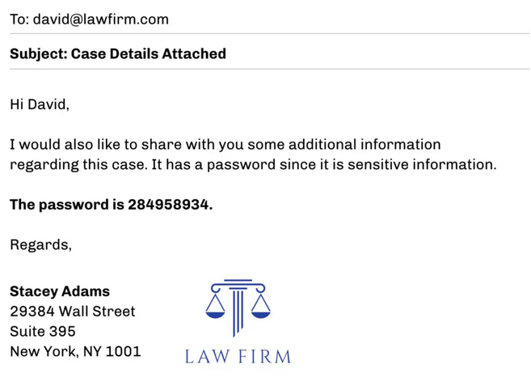
Defensive Uses of Password Cracking
Phishing Investigation
Notes:
Attackers will commonly hide malicious phishing attachments inside of password protected zip archives in order to evade antivirus scanning. In cases where the security responder does not have access to the original email, the only option to crack the password of the zip archive.

Slide 11
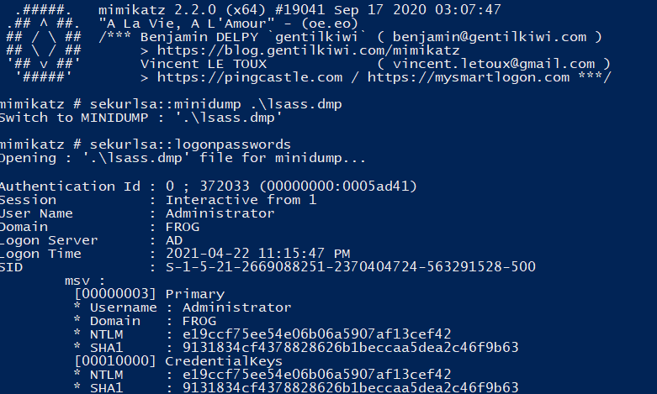
Defensive Uses of Password Cracking
Incident Response
Notes:
When investigating a breach, an incident responder may recover a password dump performed by an attacker. Running the password hashes through common dictionaries can help identify what passwords need to be changed first and what accounts an attacker might have gotten quick access to. Accounts with stronger passwords will take the attacker longer to crack, helping narrow the scope of investigation.

Slide 12
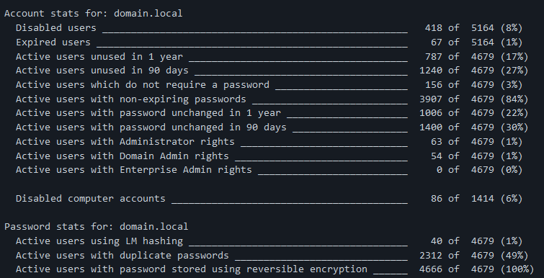
Defensive Uses of Password Cracking
Password strength auditing
Notes:
A company can dump their own password hashes and attempt to crack them in order to audit the strength of their user’s passwords.
https://github.com/Dionach/NtdsAudit

